Slide 1
Work habits & tools for reproducible research
Bryan Parthum, Ph.D.
U.S. Environmental Protection Agency
National Center for Environmental Economics
www.bryanparthum.com
Disclaimer: the views presented here are those of the speaker, and do not necessarily reflect the views of the EPA or the U.S. Government

Slide 2
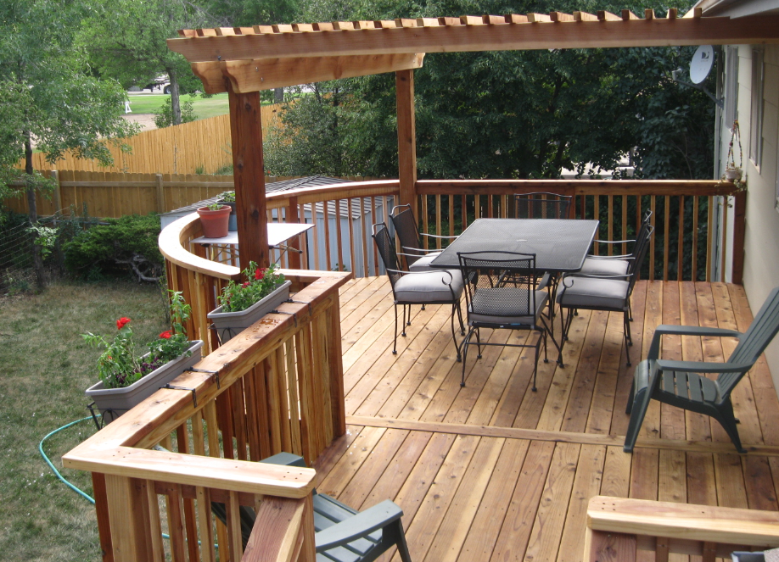

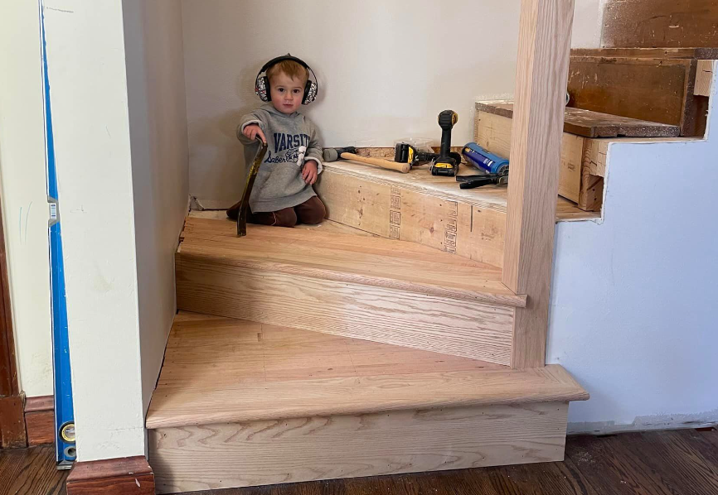
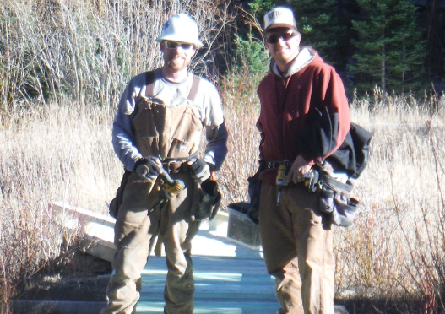
A little about me
I grew up building things, and I still do.
My father’s advice was drilled into me at an early age:
  “A clean workspace allows clean work.”
I don’t build houses anymore, but I do build research!

Slide 3
A little about me
I grew up building things, and I still do.
My father’s advice was drilled into me at an early age:
  “A clean workspace produces clean work.”
I don’t build houses anymore, but I do build research!

Slide 4
A little about me
I grew up building things, and I still do.
My father’s advice was drilled into me at an early age:
  “A clean workspace produces clean work.”
I don’t build houses anymore, but I do build research!

Slide 5
Work Habits
What are your work habits?
This is different for every person; the most important things are:
  Do what works for you!
  Recognize that this changes over time
  Periodically reflect and update your approach
Things to consider:
  Project priority (and life priorities)
  Workflow
  Switching costs

Slide 6
Work Habits
What are your work habits?
This is different for every person; the most important things are:
  Do what works for you!
  Recognize that this changes over time
  Periodically reflect and update your approach
Things to consider:
  Project priority (and life priorities)
  Workflow
  Switching costs

Slide 7
Work Habits
What are your work habits?
This is different for every person; the most important things are:
  Do what works for you!
  Recognize that this changes over time
  Periodically reflect and update your approach
Things to consider:
  Project priority (and life priorities)
  Workflow
  Switching costs

Slide 8
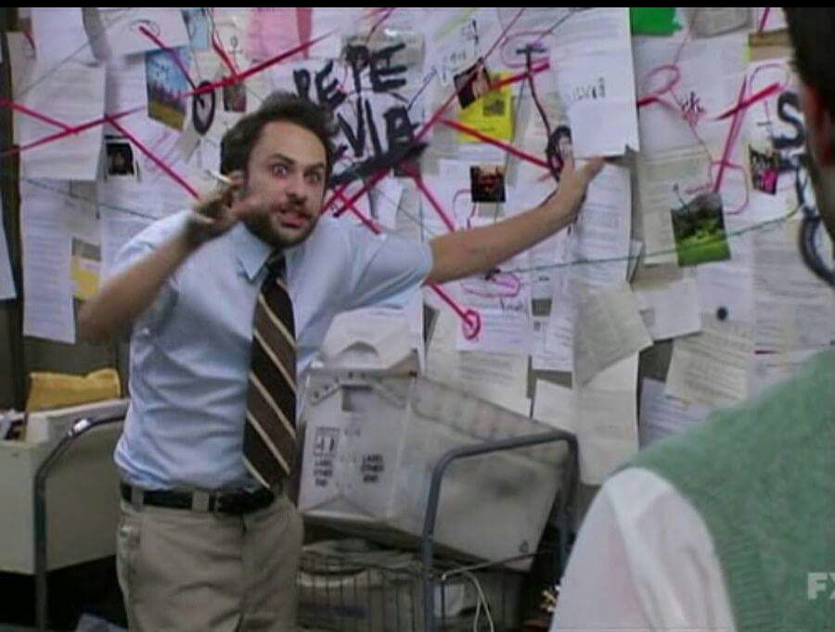
Directory Organization
Where do you keep your files?
Example with the Social Cost of Carbon

Slide 9
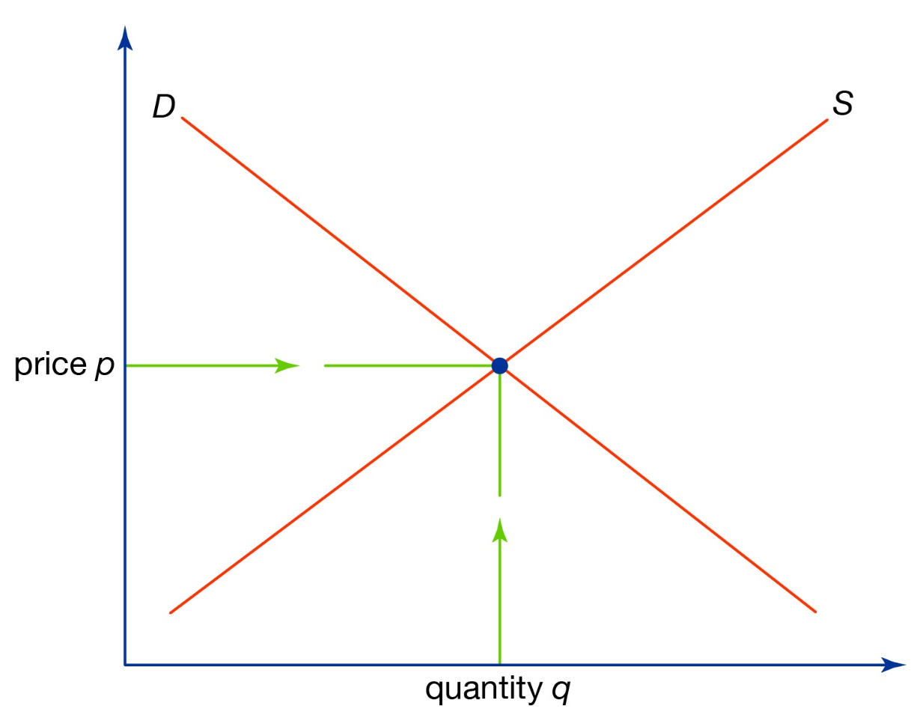
Tools for Reproducible Research
What is the research product, and who is this for?
Time
Invested
Whatever works
Reproducible
Project
Research output

Slide 10
Tools for Reproducible Research
What is the research product, and who is this for?
Time
Invested
Whatever works
Reproducible
Project
Research output
Literature
Review

Slide 11
Tools for Reproducible Research
What is the research product, and who is this for?
Time
Invested
Whatever works
Reproducible
Project
Research output
Literature
Review
Research
Notes

Slide 12
Tools for Reproducible Research
What is the research product, and who is this for?
Time
Invested
Whatever works
Reproducible
Project
Research output
Literature
Review
Research
Notes
White
Paper

Slide 13
Tools for Reproducible Research
What is the research product, and who is this for?
Time
Invested
Whatever works
Reproducible
Project
Research output
Literature
Review
Research
Notes
White
Paper
Thesis

Slide 14
Tools for Reproducible Research
What is the research product, and who is this for?
Time
Invested
Whatever works
Reproducible
Project
Research output
Literature
Review
Research
Notes
White
Paper
Thesis
Journal
Article

Slide 15
Tools for Reproducible Research
What is the research product, and who is this for?
Time
Invested
Whatever works
Reproducible
Project
Research output
Literature
Review
Research
Notes
White
Paper
Thesis
Journal
Article
Economics
Journal

Slide 16
Tools for Reproducible Research
What is the research product, and who is this for?
  There are very real fixed costs (and switching costs!) to building a foundation that is conducive to reproducible research
  This isn’t always worth it! BUT, many times it is...
You have a research idea!!!
  What are some things that you use to get started?
Okay great, you want a research paper
  Knowing this… what are your expectations?
    Timeframe, workflow, process, etc.

Slide 17

Tools for Reproducible Research
What is the research product, and who is this for?
  There are very real fixed costs (and switching costs!) to building a foundation that is conducive to reproducible research
  This isn’t always worth it! BUT, many times it is...
You have a research idea!!!
  What are some things that you use to get started?
Okay great, you want a research paper
  Knowing this… what are your expectations?
    Timeframe, workflow, process, etc.

Slide 18
Tools for Reproducible Research
What is the research product, and who is this for?
  There are very real fixed costs (and switching costs!) to building a foundation that is conducive to reproducible research
  This isn’t always worth it! BUT, many times it is...
You have a research idea!!!
  What are some things that you use to get started?
Okay great, you want a research paper
  Knowing this… what are your expectations?
    Timeframe, workflow, process, etc.

Slide 19
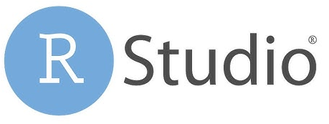



Tools for Reproducible Research
“A clean workspace produces clean work”
  Integrated Development Environments (IDE’s)
    RStudio
      The R programming language, although can be used with others
    Visual Studio Code (VScode)
      Many programming languages, typically Python, Julia, HTML, Java
    Jupyter Notebooks
      Many Programming languages, typically Python, Julia
    Spyder
      Python (but maybe others?)

Slide 20

Tools for Reproducible Research
  R-markdown and Jupyter Notebooks
    Pros:
      Great for local, systematic progression of research questions
      Can even write a whole paper (or presentation)!
    Cons:
      Markdown language/HTML is another thing to learn.
      Pretty restrictive in formatting and look (although they have some good options!)
      Difficult to collaborate, not many users
    Example problem set assignment

Slide 21
Tools for Reproducible Research
  R-markdown and Jupyter Notebooks
    Pros:
      Great for local, systematic progression of research questions
      Can even write a whole paper (or presentation)!
    Cons:
      Markdown language/HTML is another thing to learn.
      Pretty restrictive in formatting and look (although they have some good options!)
      Difficult to collaborate, not many users
    Example problem set assignment

Slide 22
Tools for Reproducible Research
  R-markdown and Jupyter Notebooks
    Pros:
      Great for local, systematic progression of research questions
      Can even write a whole paper (or presentation)!
    Cons:
      Markdown language/HTML is another thing to learn.
      Pretty restrictive in formatting and look (although they have some good options!)
      Difficult to collaborate, not many users
    Example problem set assignment

Slide 23

Tools for Reproducible Research
  GitHub
    Pros:
      Really nice for compartmentalizing your research
      Comparing changes in code (called “dif” or “differencing”, e.g.)
      Versioning and collaboration (originally designed for this)
    Cons:
      Can be slightly tricky to learn (but SO worth it!)
      Not ideal for data transfer, no large files, etc.
    You really shouldn’t live without this

Slide 24
Tools for Reproducible Research
  GitHub
    Pros:
      Really nice for compartmentalizing your research
      Comparing changes in code (called “dif” or “differencing”, e.g.)
      Versioning and collaboration (originally designed for this)
    Cons:
      Can be slightly tricky to learn (but SO worth it!)
      Not ideal for data transfer, no large files, etc.
    You really shouldn’t live without this

Slide 25
Tools for Reproducible Research
  GitHub
    Pros:
      Really nice for compartmentalizing your research
      Comparing changes in code (called “dif” or “differencing”, e.g.)
      Versioning and collaboration (originally designed for this)
    Cons:
      Can be slightly tricky to learn (but SO worth it!)
      Not ideal for data transfer, no large files, etc.
    You really shouldn’t live without this

Slide 26
Example Repositories
The Social Cost of Greenhouse Gases
Hydrofluorocarbons and the Kigali Amendment
Willingness to ay to Improve Surface Water Quality
Greenhouse Gas Impact Value Estimator (GIVE)
PRISM Weather Data Extraction
North American Ski Resorts

